Slide 1
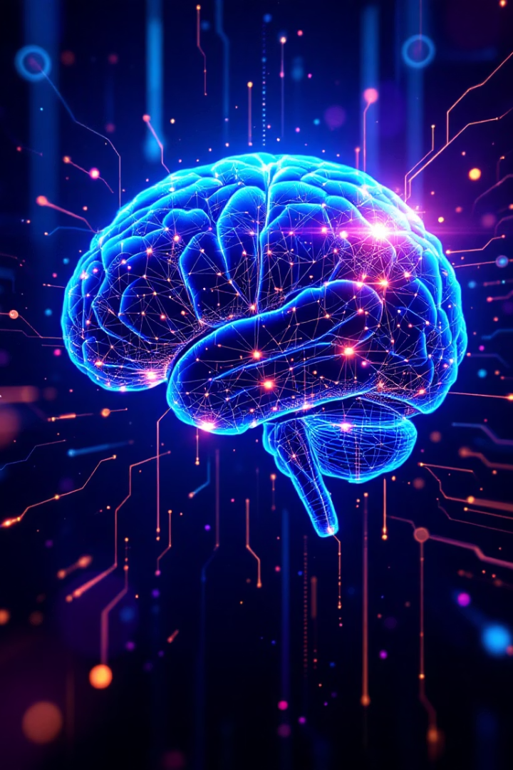
🧠 [TRUTH] IN THE AGE OF MACHINES
Multimodal Generative AI Against Real-Time Misinformation

Slide 2
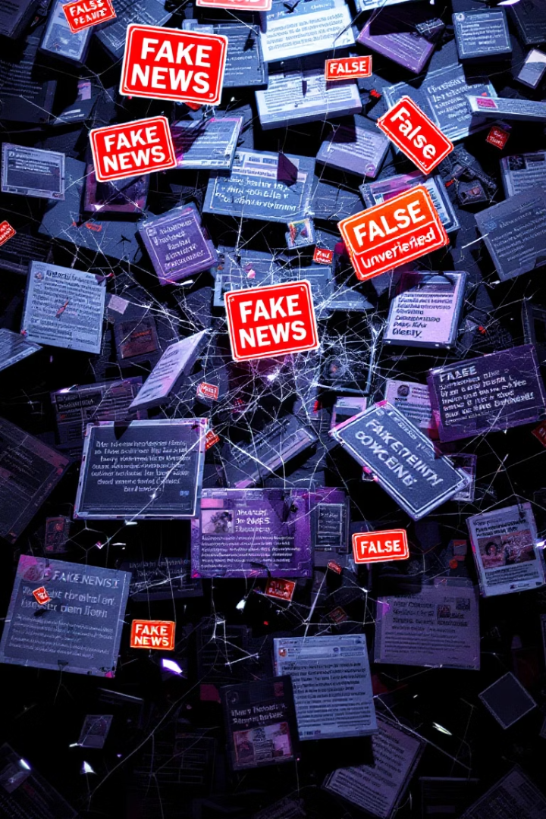
🌍 The Misinformation Pandemic
Speed of Fake News
Global Cost
Fake news spreads 6x faster than real news (MIT Study, 2018)
$78 billion lost worldwide due to misinformation in 2022
Trust in Crisis
Trust erosion is the real danger beyond just falsehoods

Slide 3
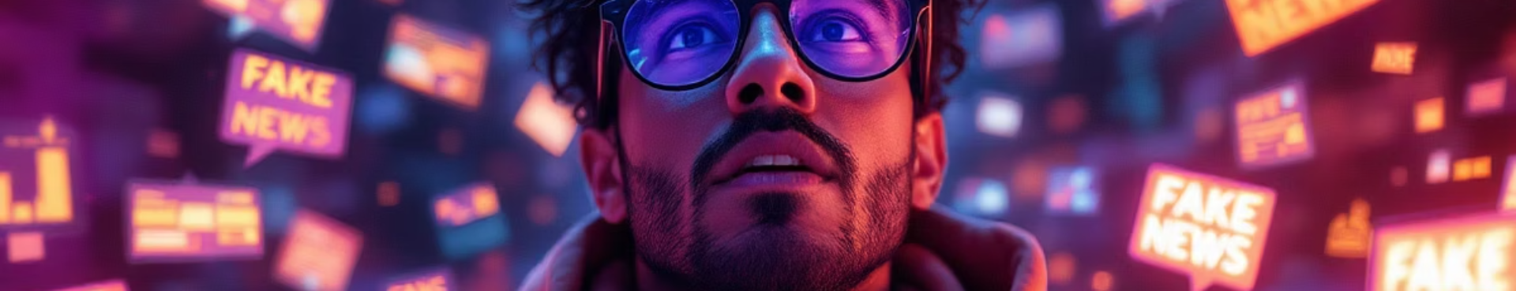
📊 The Reality Check
Decreasing Detection
Unknowing Spread
70% find it increasingly difficult to detect real news
Frequent Exposure
52% share misinformation unknowingly with peers
86% of users regularly encounter fake news online
Example: AI disproves a viral herb-cancer cure by fact-checking medical data instantly.

Slide 4
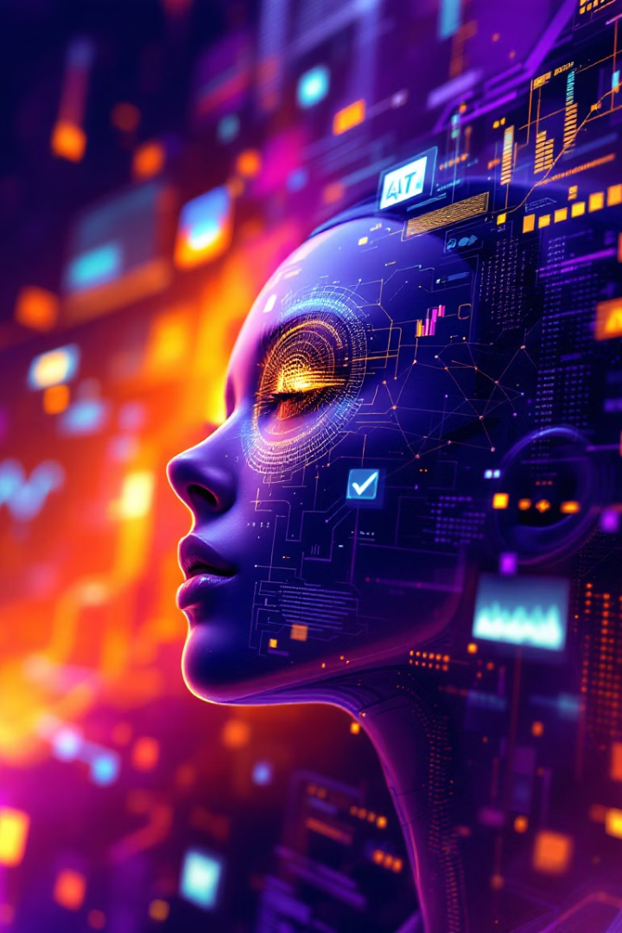




🤖 Enter Generative AI: The Digital Vaccine
Automated Fact Verification
GPT models cross-check facts via trusted official sources
Deepfake Detection
Flags inconsistencies in facial movements and audio-visual cues
Language Analysis
Detects sensationalism, emotional tone, and repetitive phrasing
Social Media Monitoring
Identifies bots and coordinated misinformation campaigns

Slide 5
🔧 Real-World Use Cases
PolitiFact
Meta
X (Twitter)
AI verifies political claims with rapid fact checks
Removed 1.5 billion fake accounts in Q1 2023 using AI
Lowered misinformation spread by 48% with advanced AI tools

Slide 6
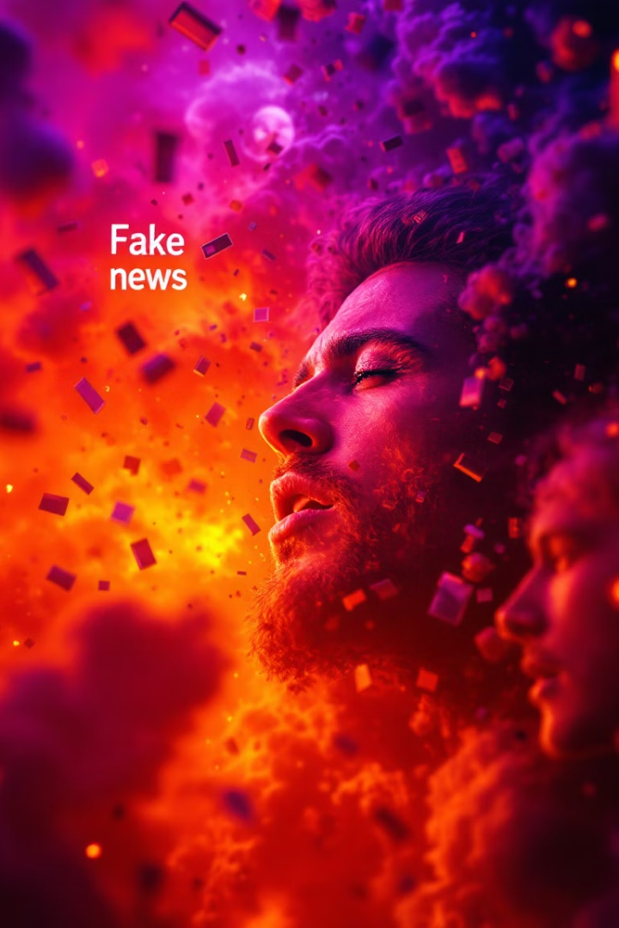
⚔️ Chaos-Causing Fake News Examples
1
Political Assassination Hoax
False claim of PM Modi's assassination causing mass panic
2
COVID Vaccine Disinformation
Fabricated study causing vaccine hesitancy and protests
3
Cross-Border Terrorism Claim
Unfounded Chinese intelligence terrorism plot spreading fear

Slide 7
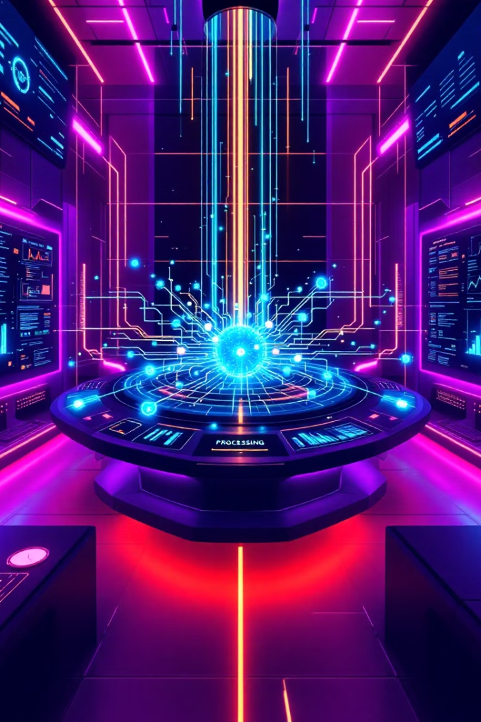
🔬 Novelty of Our Project
1
Multimodal Agent Pipeline
2
Open and Transparent AI
First-of-its-kind tech combines OCR, image reasoning, and search
Builds user trust with transparent operations and explanations
3
Designed for Scale
Supports local languages and critical thinking education

Slide 8
📊 System Architecture
Text/Image Input
LangChain agents & LLMs
OCR if image
OpenAI GPT-4 & GPT-3.5 Turbo
Search (DuckDuckGo, Wikipedia)
Streamlit UI interface
GPT-based Agent Analysis
PIL, Tesseract OCR, DuckDuckGo, Wikipedia APIs
Verdict: Fake / Real / Uncertain
Explanation Output

Slide 9

📉 Impact Areas
Journalism Verification
Political Monitoring
Empowering reporters with instant fact-checking tools
Tracking misinformation during elections in real time
Health Misinformation
Messaging Apps
Detecting and stopping dangerous false health claims
Fact-checking bots for WhatsApp, Telegram platforms

Slide 10
🌐 Future Extensions & Conclusion
Real-time Telegram & X integrations
"In digital chaos, AI acts not just as a filter but a mentor."
Voice-based fake news analysis
Indian language support (Hindi, Bengali, Tamil)
NGO and Government collaboration for scale

